Slide 1
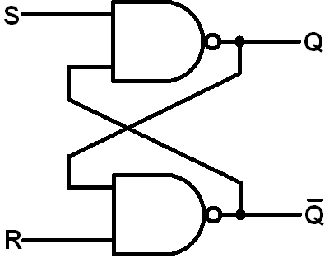
SR Latch Design
Module Tutor: Mr. Vincent Ho
Presenter: Penjor Namgay Tamang(02210181)

Slide 2
Outline
Introduction
Aim and Objective
Design and Methodology
Schematic
Layout Design
Design Rule Check ( DRC)
Layout Vs. Schematic (LVS)
Result and Analysis
Conclusion

Slide 3
Introduction
The SR latch, or Set-Reset latch, is a basic digital memory element used to store a single bit of data. It operates with two inputs—set (S) and reset (R)—which control whether the output holds a high (1) or low (0) state. Constructed from cross-coupled transistors, the SR latch retains its state even when inputs are removed, making it suitable for applications requiring stable data retention. In this experiment, we designed and simulated an SR latch using 45nm technology in Cadence, allowing for analysis of its performance, stability, and behavior in response to input changes.

Slide 4
Aim
To design and simulate an SR latch using NMOS and PMOS transistors in 45nm technology with Cadence software.

Slide 5
Objectives
Create the schematic and layout of the SR latch using NMOS and PMOS transistors.
Perform Design Rule Check (DRC) and Layout vs. Schematic (LVS) verification.
Verify the latch’s ability to store one bit based on set (S) and reset (R) inputs.
Study the behavior of the cross-coupled inverter configuration in maintaining the latch state.

Slide 6
Design and Methodology
Schematic design
Simulation
Layout Design
Verification
Performance Analysis

Slide 7
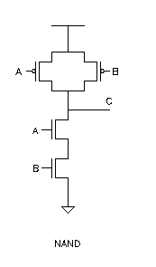
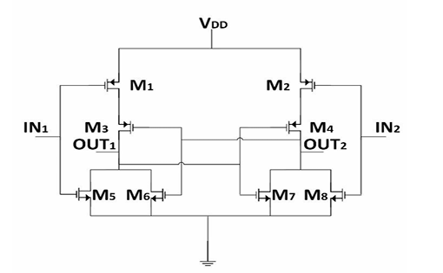
Transistor level NAND gate and SR Latch Design

Slide 8
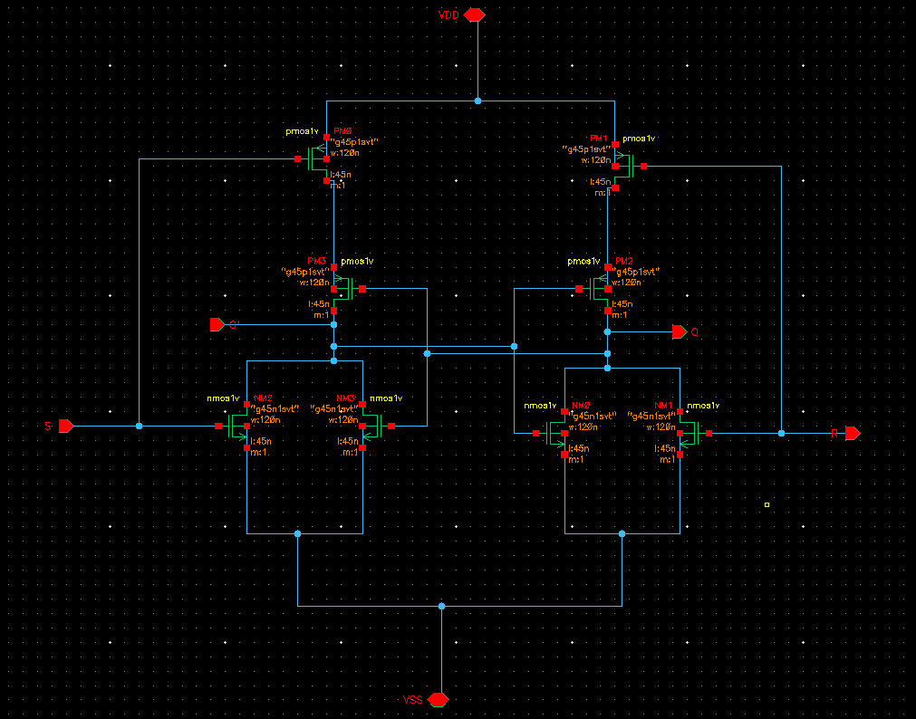
Schematic Diagram
Fig 1. Schematic Diagram

Slide 9
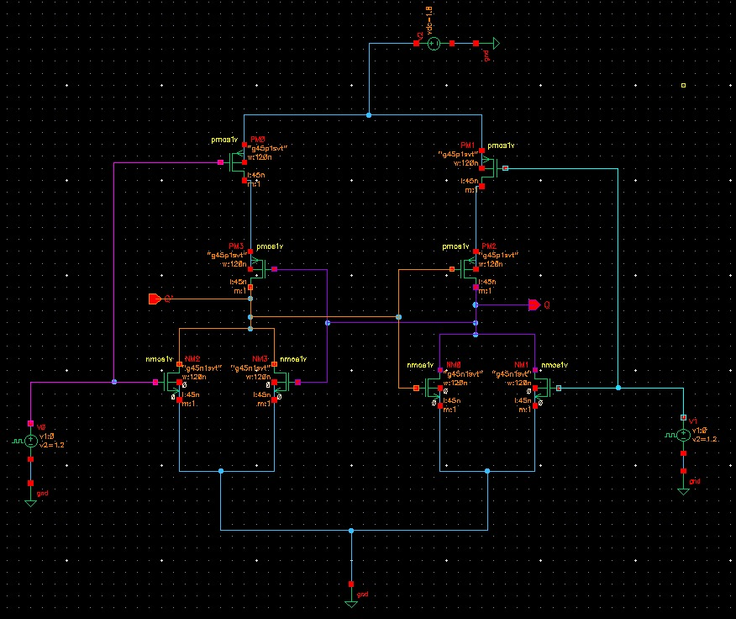
SR Latch Test Bench
Fig 2. SR Latch Test bench

Slide 10
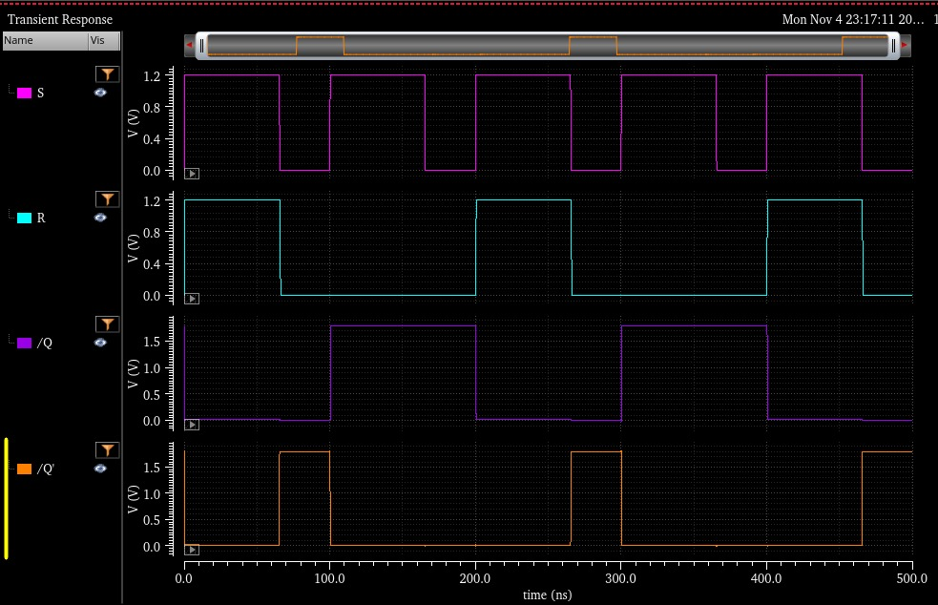
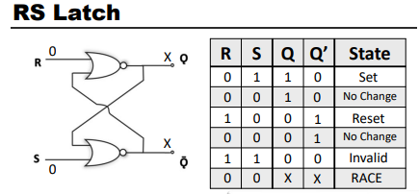
Pre Layout Simulation
Fig 3. Transient Analysis

Slide 11
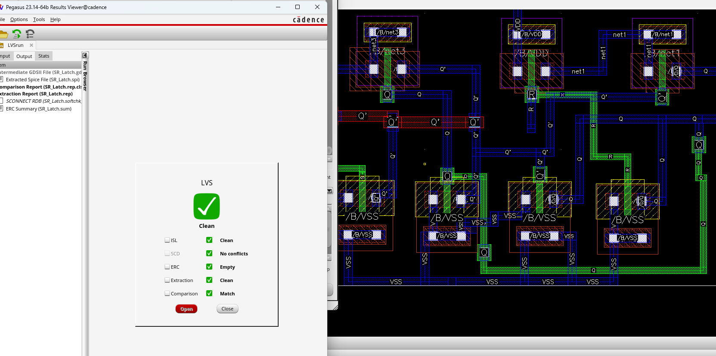
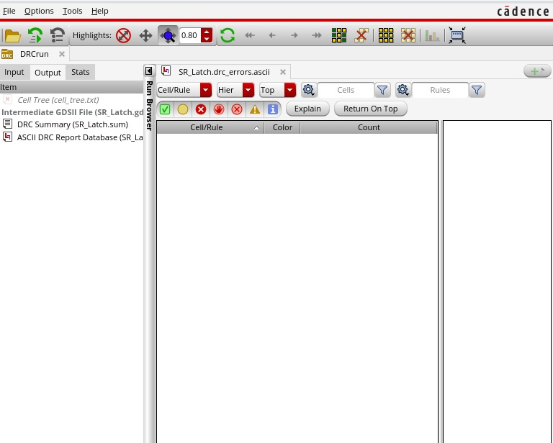
DRC Test and LVS Test
Fig 5. No errors in DRC Test
Fig 6. Clean LVS

Slide 12
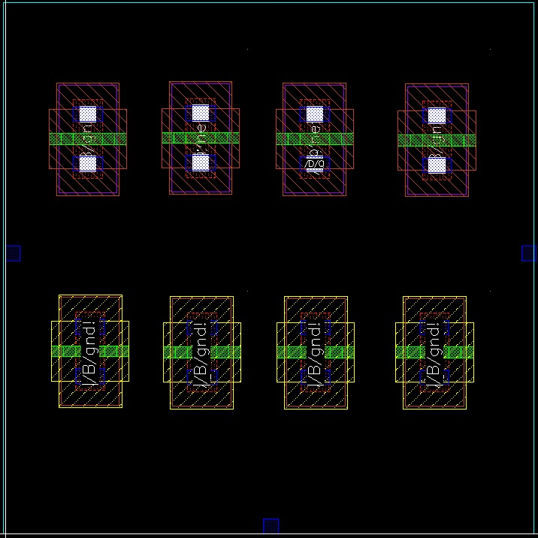
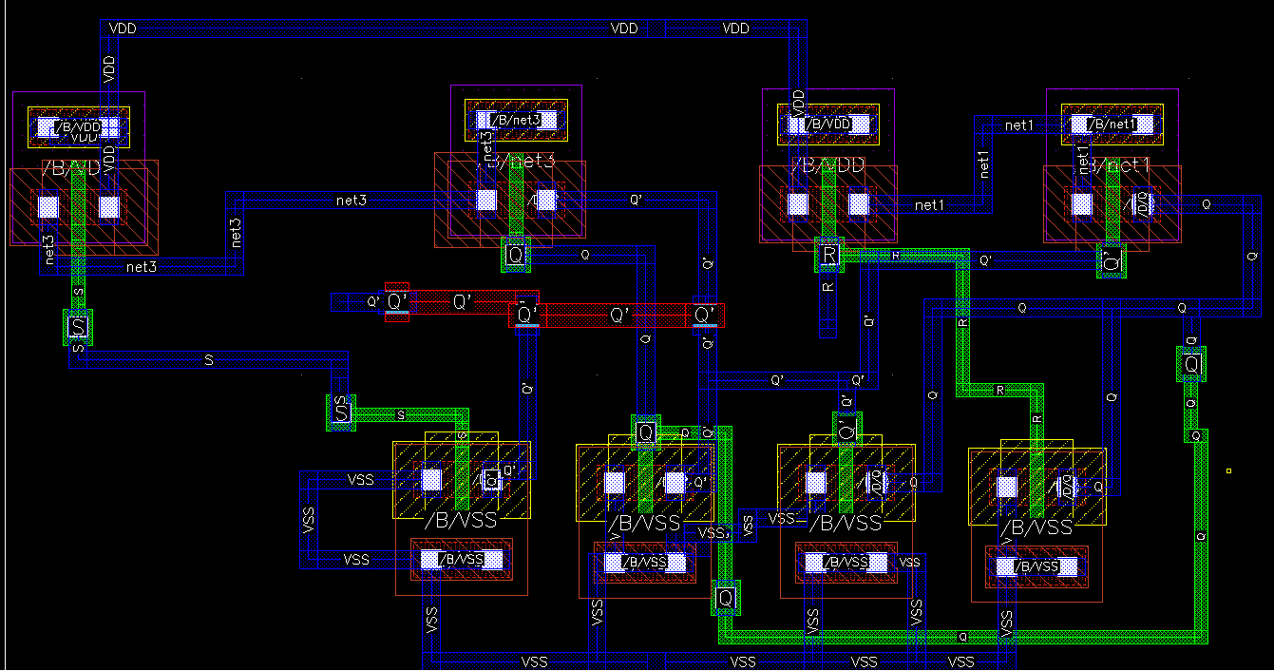
Layout
Fig 7. Layout

Slide 13
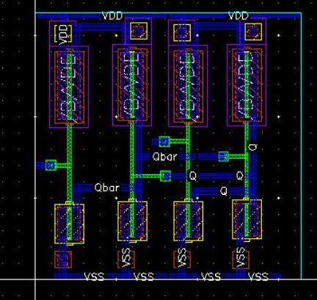
SR Latch Layout

Slide 14
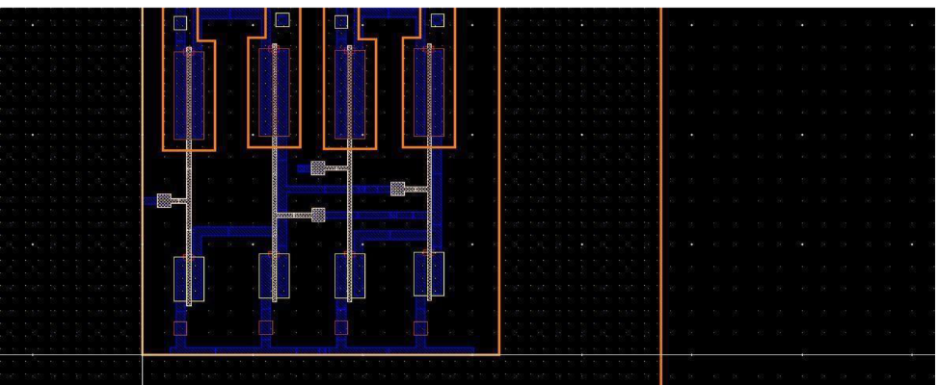
AV_Extracted

Slide 15
Post Layout Simulations

Slide 16
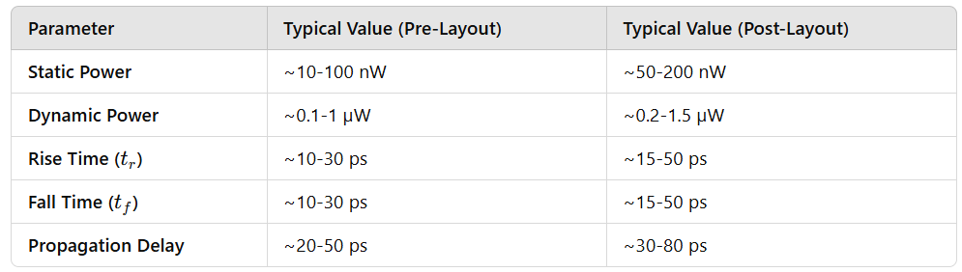
Standard Value

Slide 17
Result and Analysis
Type | Static Power (nW) | Dynamic Power (uW) | Rise Time (psec) | Fall Time (psec) | Delay (ps)
Pre Layout Simulation | 25.66 | 0.34 | 15.11 | 25.73 | 35
Post Layout Simulation | 52.554 | 0.71 | 25.32 | 37.4 | 60

Slide 18
Result and Analysis
The SR latch simulation confirmed its expected behavior according to the truth table. The results were as follows:
- S = 0, R = 0: The latch retained its previous state.
- S = 0, R = 1: The latch was reset, setting output Q to 0.
- S = 1, R = 0: The latch was set, changing output Q to 1.
- S = 1, R = 1: An indeterminate or metastable state occurred.
Overall, the simulation effectively demonstrated the SR latch's functionality across various input combinations.

Slide 19
Conclusion
The successful design and simulation of an SR latch using NMOS and PMOS transistors in 45 nm technology with Cadence demonstrated expected behavior and adherence to layout rules. This experiment provided insights into the operation of SR latches with complementary MOSFETs and highlighted the capabilities of Cadence for digital circuit design.

Slide 20
References
Study Materials. (2018, August 30). Layout Tutorial in Cadence Tool- SR Latch [Video]. YouTube. https://www.youtube.com/watch?v=fUJL5SEGki0
He, Y. and Yuan, G. (2022). A 1.2 V high‐speed low‐power preamplifier latch‐based comparator. Electronics Letters, 58(24), pp.896–898. doi:https://doi.org/10.1049/ell2.12636.

Slide 21
Thank You

